Slide 1
Capstone Project - Story Telling
Web and Social Media Analytics
Rajesh Bairangula
Vinita Bihani
Radhika Sharma

Slide 2
AGENDA
Understanding Problem Statement
Framing Objectives
Processes / methods involved
Key findings
Recommendations

Slide 3
Problem Statement
Customer is a mobile manufacturer based in the US, who entered the market three years ago.
As a new entrant in the sector, they want to understand their competitors and preferences of their users so that they can design their strategies accordingly.
They want to tweak the marketing strategies to add more value to their brand, provide features to customers that add the most value, and close the demand-supply gap.
Their objective is to increase the market share as well as the brand value.

Slide 4
Objectives
Development of features that have high utility value for the customers
User experience with the current devices
Strength and weaknesses of competitors
Market share of the competitors
Pricing strategies based on features, utility and competitor's pricing strategies

Slide 5
METHODS TO BE ADAPTED
CLEANING AND PRE-PROCESSING OF THE DATA
TEXT ANALYTICS WITH NLP TO REVIEW THE CUSTOMER SENTIMENT
BUILDING A SENTIMENT CLASSIFICATION ENGINE USING NAIVE BAIYES AND ML STATISTICS
BUILDING DASHBOARDS IN TABLEAU FOR BETTER UNDERSTANDING
MAKING SUITABLE RECOMMENDATIONS

Slide 6
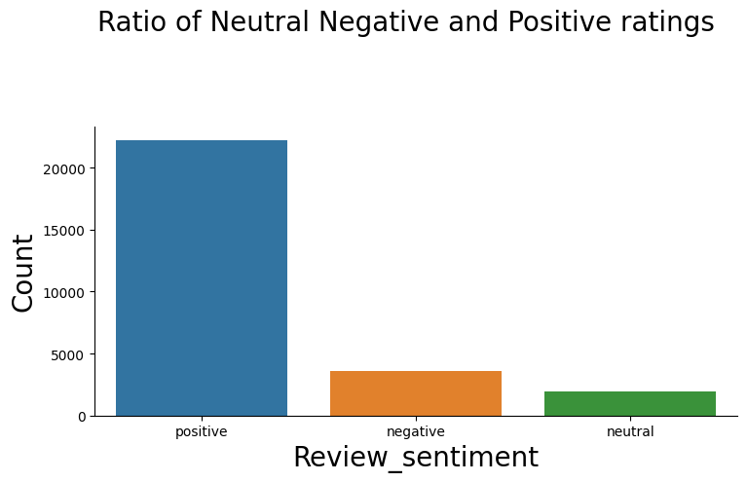
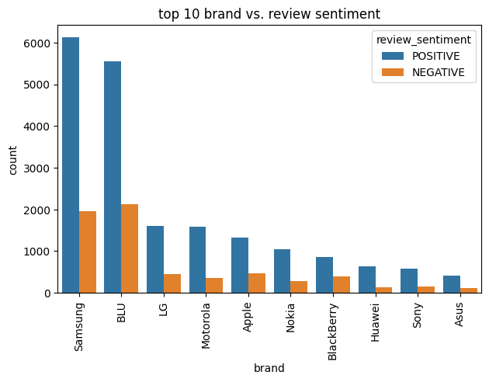
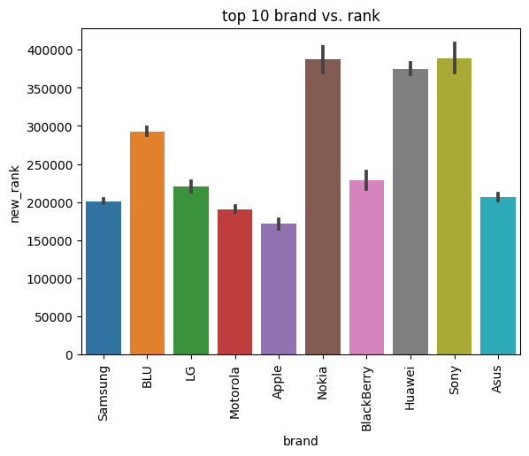
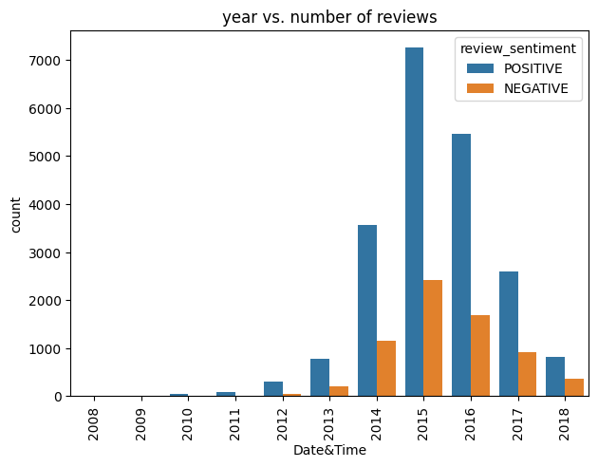
VISUALISATION OF DIFFERENT CATEGORIES

Slide 7
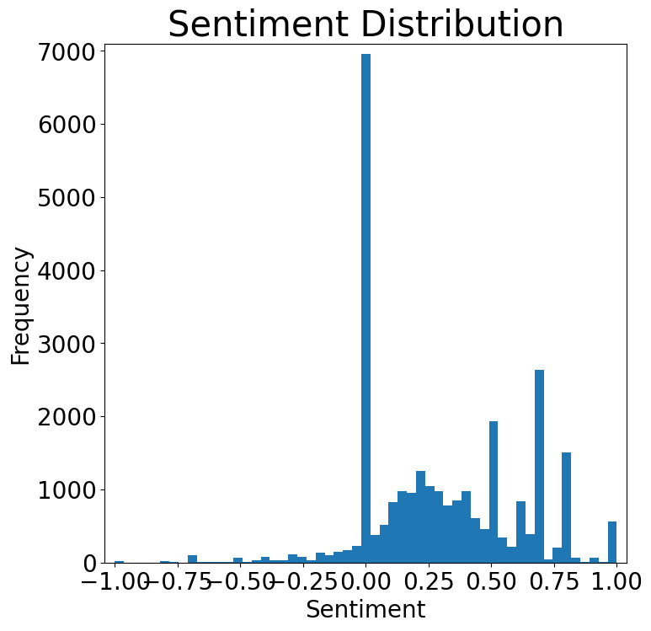
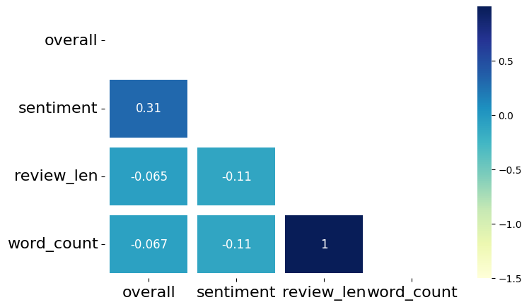
Distribution of sentiment analysis across the dataset
It is observed that people gave feedback only in case of positive feelings and not shown any interest in givining feedback when they felt negative about the product.

Slide 8
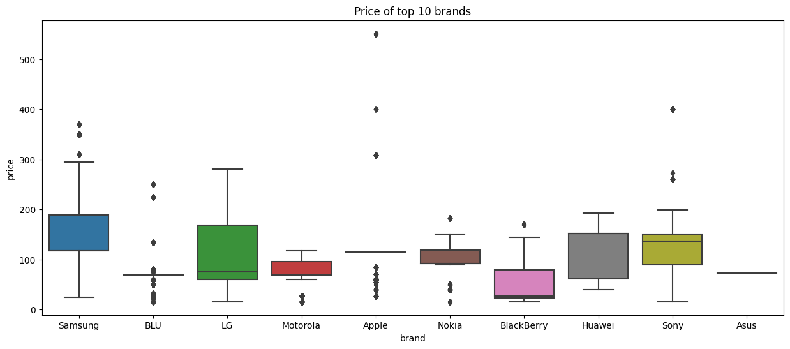
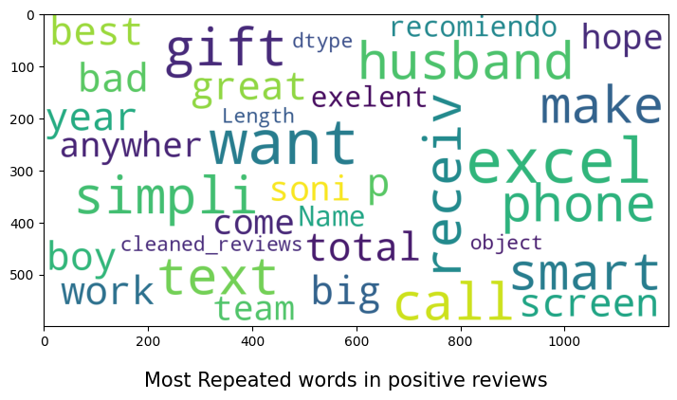
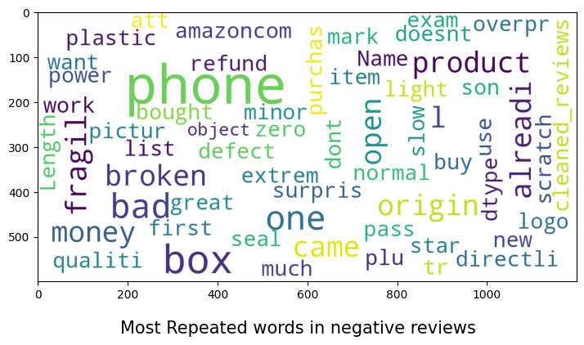
Distribution of words in the dataset.
Price Distribution among various brands. Most reviews comes 0 to 300 dollars

Slide 9
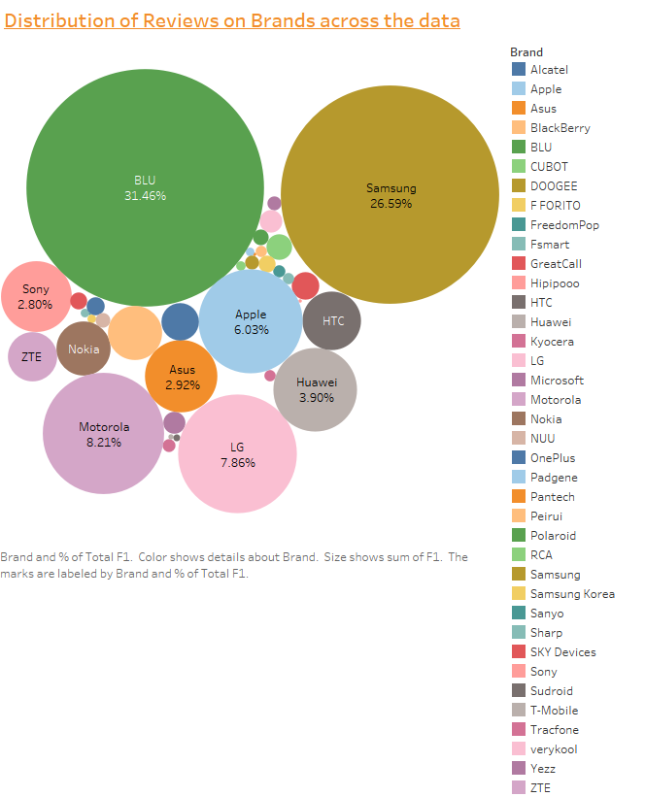
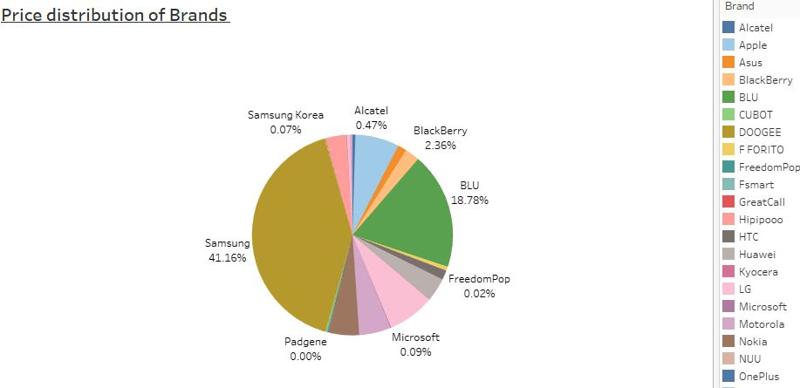
The most reviewed brand from the data set is BLU (31.46% ) followed by Samsung and Motorolla.
There are other brands which also share the market at par with each other, but not as much as Samsung and Blu.
The price distribution analysis shows that Samsung share 41.16 % , BLU share 18.78%, LG 7.58% followed by Apple with 7.08%.
To understand the market, the features provided by the major share holders are to be considered in developing the new features.

Slide 10
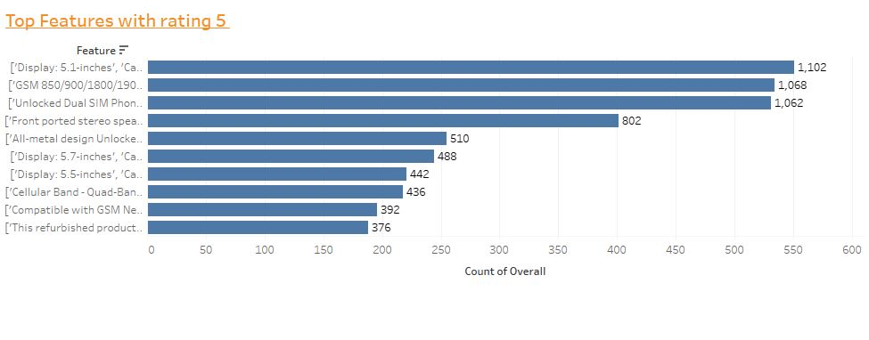
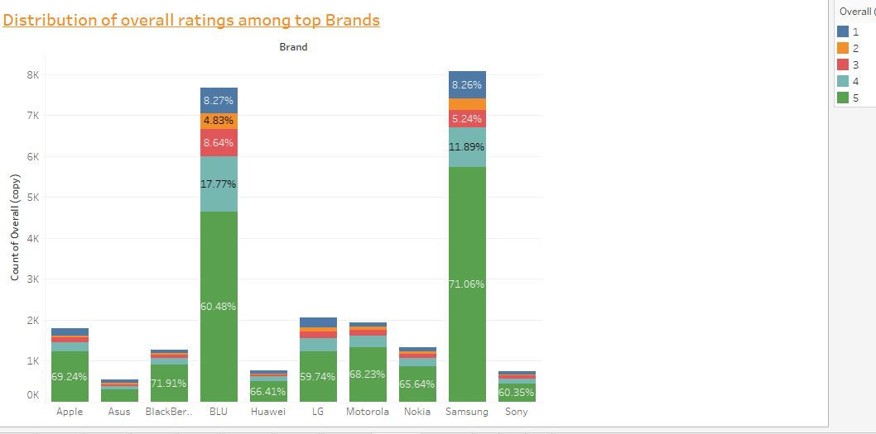
Most of the features which are highly rated include a good resolution camera, display size of 5.1inches and above, high resolution display and a good processor of 2.5 GHz.
It is also pertinent to note that the above mentioned features seems to be mostly liked and the others may vary dependending on individual requirements.
If we see the brand performance with respect to rating, Samsung and BLU remains at top with highest number of ratings.
If number of high ratings out of the total ratings received are considered, few brands such as Apple and BlackBerry which holds the low market share also have good percent of high ratings.

Slide 11
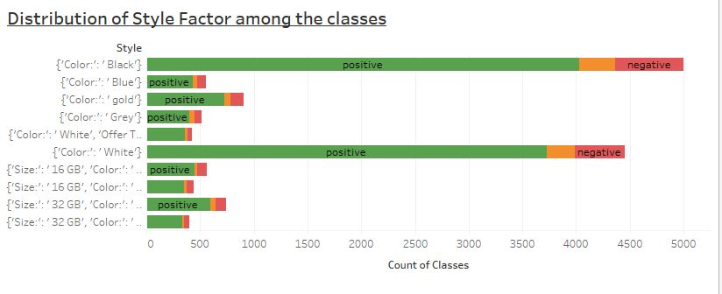
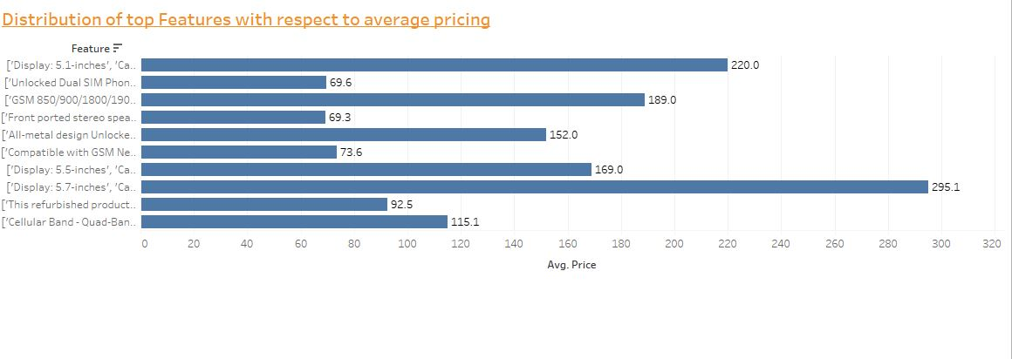
Style factor is also considered while analysing the reviews.
The highly reviewed style is “Color Black and followed by “Color White”.
Memory size also played a good role in capturing the customer attention.
The features with highest average pricing and most rated high are display size of 5.7 inches, a camera of 16 MP and 2.7 GHz processor along with Andriod OS.
Not all the features which recieved positive ratings are costly, some also fall between 65$ to 150$.

Slide 12
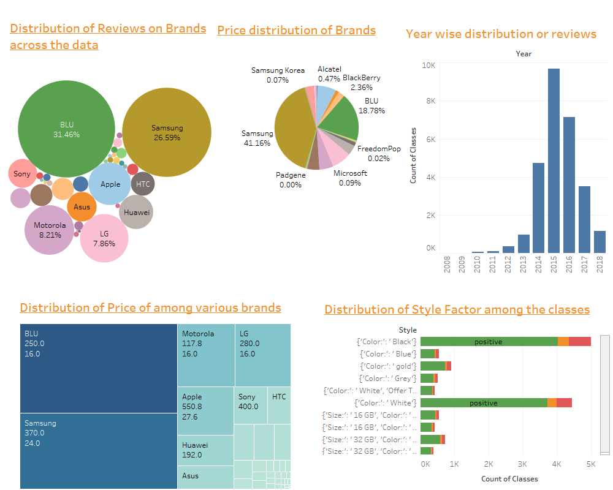
Web and Social Media Analytics

Slide 13
Recommendations and conclusions
By analysing the sentiment of the reviews, it is understood that features incorporated by major brands should be included in developing a new product.
The pricing should be maintained between a range of 70 to 150 Dollors , as to attract the majority of the customer segment which fall between this range.
Features such as High resolution Camera with 16 MP and display size of 5.7 inches and 2.7 GHz processor are most desired by the customer. Companies should emphasize on developing a better version of these features.
Also OS Android holds the major share of the market. This should be not ignored while designing the new products. Style adds more attraction to the product. Hence, a style and design would do great.

Slide 14
THANK YOU

